Slide 1
CPE393 · DATA SCIENCE WITH PYTHON · KMUTT · SUMMER 2026
Predicting Airbnb
Listing Prices
in six major US cities
Group 15
Mathieu · Serghei · Samy
Exchange students from EISEA
Instructors
Ajan Aye Hninn Khine
Ajan Naveed Sultan
Notes:
All three introduce themselves. Hook: predict Airbnb prices from listing features. Regression, target log_price.

Slide 2
THE PROBLEM
What should a listing cost per night?
Hosts want a price that fills the calendar without losing income. Guests want to know if a listing is fair. Airbnb's own tool is a black box.
We ask a simpler question: using only public listing features, how well can standard models predict the price?
Task
Supervised regression
Target
log_price (log of the nightly price)
Why log?
Raw prices are skewed; the log is close to symmetric
Prices are from 2017-2018, so this is a study, not a live pricing tool.
CPE393 | Group 15
2
Notes:
Mathieu. Frame the problem and the goal: a clean pipeline, honest about limits.

Slide 3
THE DATA
Two files, six cities
train.csv
test.csv
74,111 rows · has the price
25,458 rows · no price
Used for exploration, cleaning, training, and validation.
Used only to generate predictions for unseen listings.
Listings per city (train.csv)
City | Listings
New York City | 32,349
Los Angeles | 22,453
San Francisco | 6,434
Washington DC | 5,688
Chicago | 3,719
Boston | 3,468
What's inside
Numeric: capacity, bedrooms, bathrooms, beds, reviews, rating
Categorical: room type, property type, cancellation policy, city
Location: exact latitude and longitude
NYC and LA are about three quarters of the data
CPE393 | Group 15
3
Notes:
Mathieu. Stress the two-file setup: test has no price, so we can't score on it.

Slide 4
CLEANING
One pipeline, fitted on training data only
1
2
3
4
Split train.csv
Missing values
Encoding
Scaling
80/20 train/validation, seed 42 (test has no price)
Median for numbers, a 'missing' category for text
LabelEncoder turns categories into integers
StandardScaler on the numeric features
No data leakage. Medians, encoders, and the scaler are all fitted on training data, then applied unchanged to the validation and test sets.
CPE393 | Group 15
4
Notes:
Mathieu. Emphasize anti-leakage. Graders care about this.

Slide 5
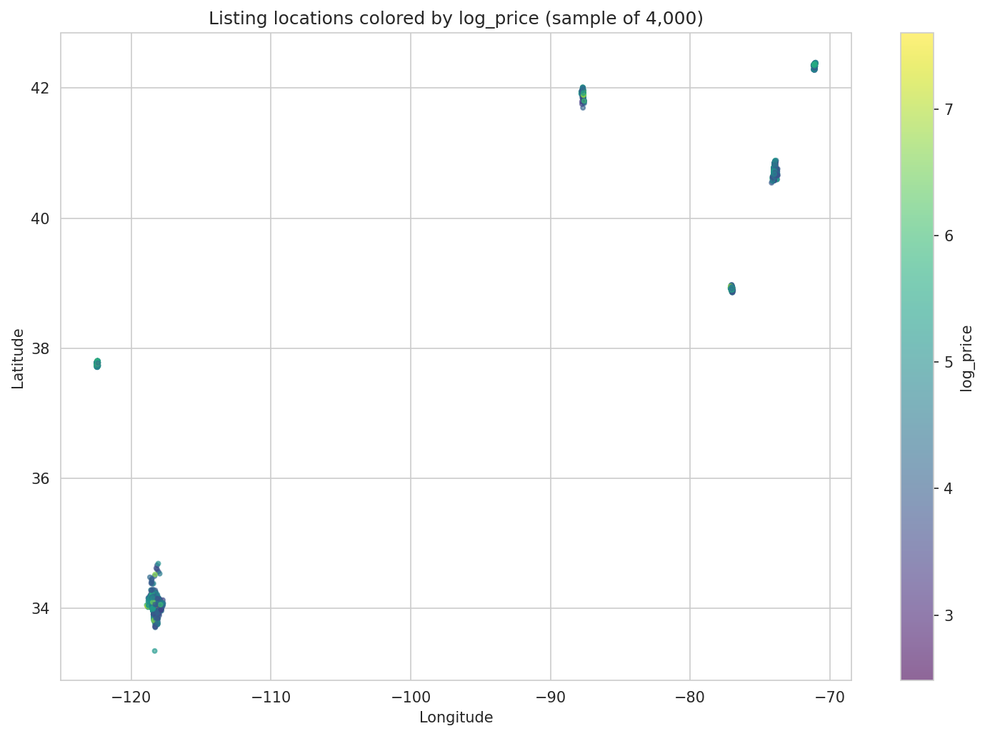
EXPLORATION
Where the listings are
On the map
The notebook has an interactive Folium map you can zoom and click.
Six clear clusters, one per city.
Inside each city, pricier listings sit in the central and coastal areas.
CPE393 | Group 15
5
Notes:
Serghei. Mention it's interactive in the notebook. Distributions: most listings small, ratings near the top.

Slide 6
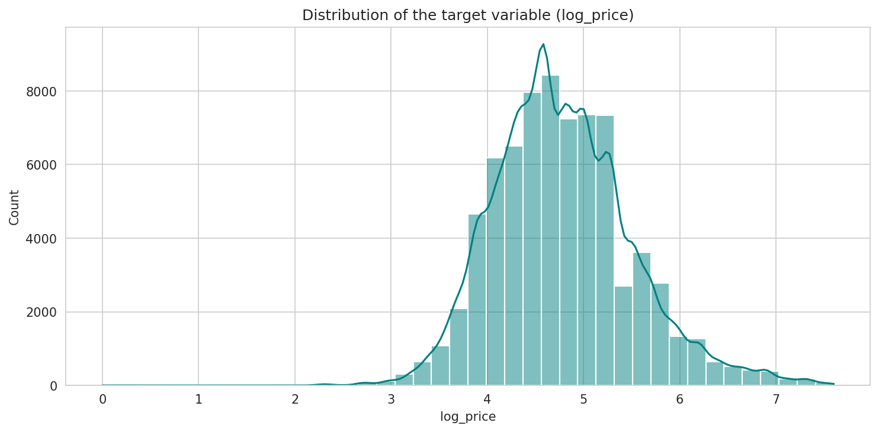
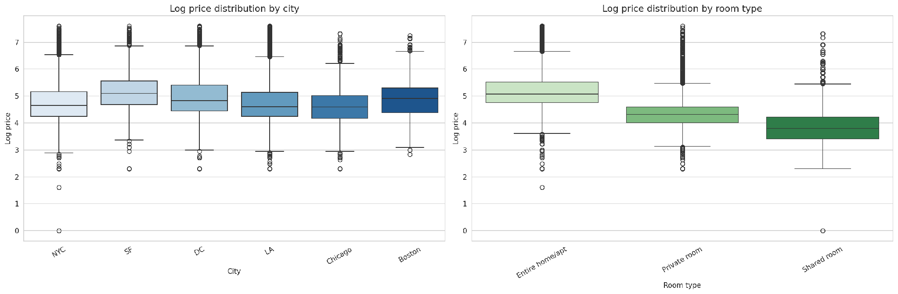
EXPLORATION
The log price, and what moves it
The target is roughly bell-shaped after the log.
SF and Boston are priciest, Chicago the cheapest.
Entire home > private room > shared room.
CPE393 | Group 15
6
Notes:
Serghei. Top-left is the target. Bottom is price by city and room type. Both look like strong predictors.

Slide 7
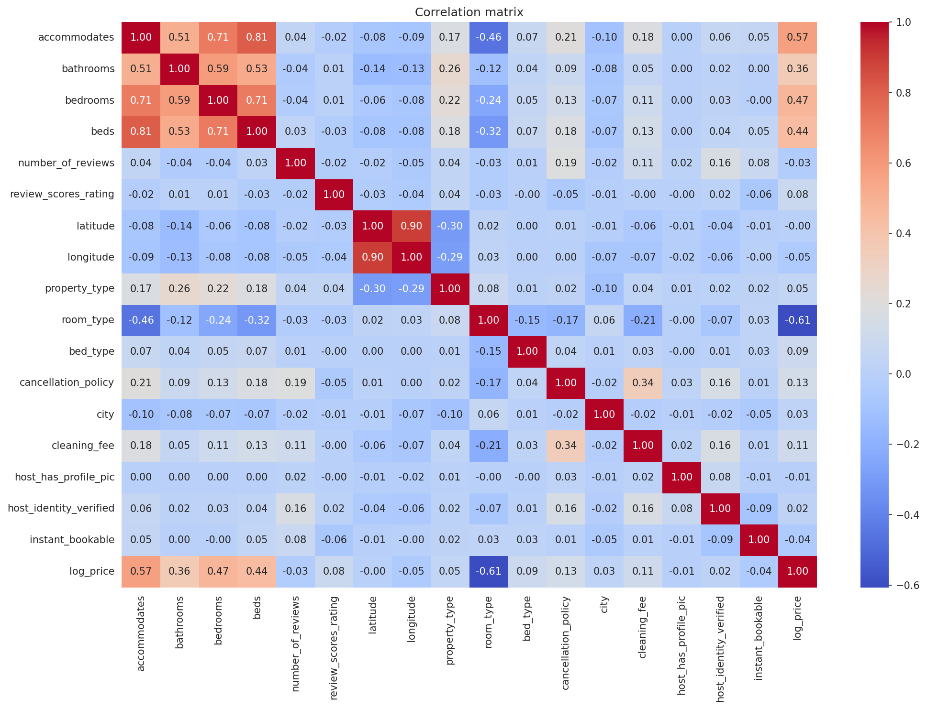
EXPLORATION
What correlates with price
Strongest linear links to log_price
room_type
-0.61
accommodates
+0.57
bedrooms
+0.47
beds
+0.44
bathrooms
+0.36
Latitude and longitude look flat here, but a tree can still use them.
CPE393 | Group 15
7
Notes:
Serghei. Note the gap: coordinates look weak here but matter to the forest.

Slide 8
MODELING
Four models, from simple to strong
Linear
Ridge
Random Forest
Gradient Boosting
Plain straight-line baseline.
Linear with a penalty on large coefficients.
Many independent trees, averaged.
Trees built in sequence, each fixing the last.
Same split (seed 42), same three metrics. We pick the final model by hand, not automatically.
CPE393 | Group 15
8
Notes:
Samy. Two linear, two tree-based. Forest averages trees; boosting builds them in sequence.

Slide 9
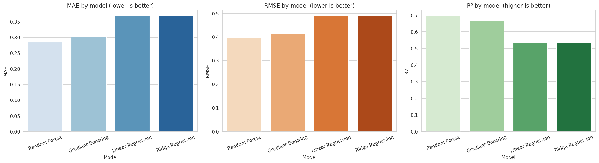
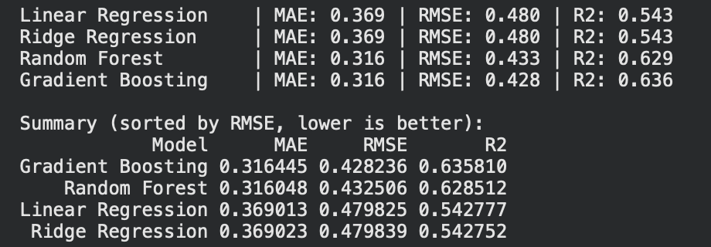
RESULTS
The tree models win, Random Forest first
Model | MAE | RMSE | R²
Random Forest | 0.285 | 0.396 | 0.695
Gradient Boosting | 0.303 | 0.413 | 0.667
Linear Regression | 0.368 | 0.489 | 0.535
Ridge Regression | 0.368 | 0.489 | 0.535
The two linear models tie: with scaled features the Ridge penalty barely changes the fit. We kept the Random Forest, which also gives feature importances.
CPE393 | Group 15
9
Notes:
Samy. RF best, GB close. Linear/Ridge identical. We chose RF by hand.

Slide 10
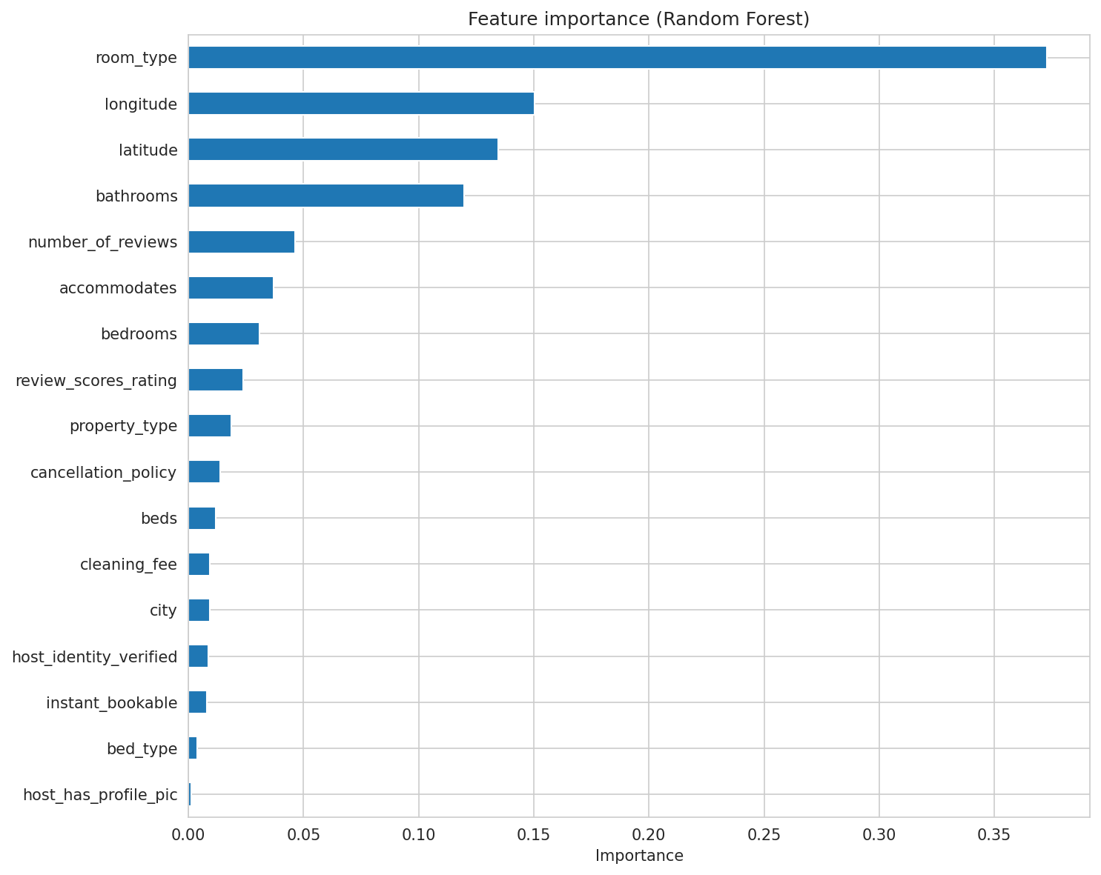
RESULTS
What it uses, and is it healthy
Top drivers
Room type — about 37%
Location (long + lat) — about 28%
Bathrooms — about 12%
Is the model healthy?
Predictions line up along the diagonal.
Residuals are centered on zero, no pattern.
So it isn't systematically over or under predicting.
CPE393 | Group 15
10
Notes:
Samy. Location matters to the tree despite weak correlation. Residuals centered = healthy model.

Slide 11
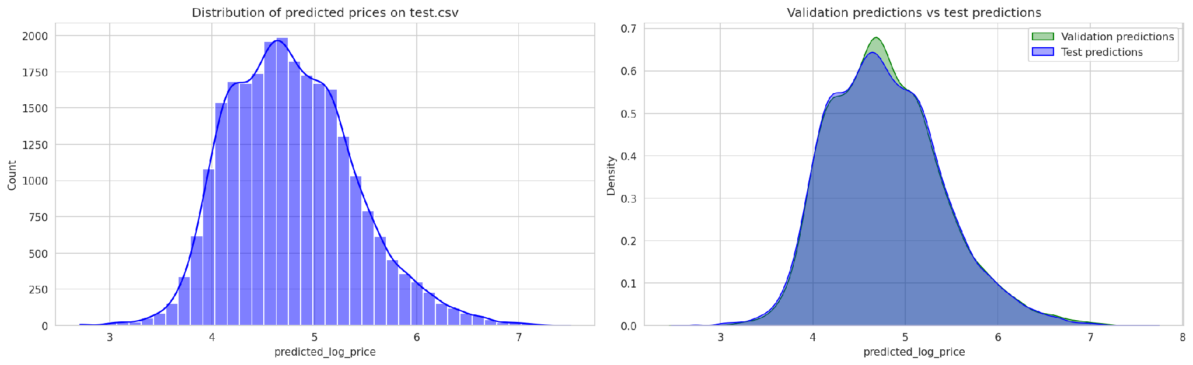
RESULTS
Predictions on the test file
The test file has no real prices, so we can't score it. But the prices the model predicts for it follow almost the same distribution as our validation predictions, so it behaves consistently on unseen data. We saved all 25,458 predictions to airbnb_predictions.csv.
CPE393 | Group 15
11
Notes:
Samy. No labels on test, so no metrics. Distributions match, which is the sign we want.

Slide 12
RESPONSIBLE AI
Bias, privacy, and honest reporting
Geographic bias
No personal data
NYC and LA dominate, so the model is weaker for Boston and Chicago.
Host and free-text columns were removed before training.
No leakage
Honest reporting
Cleaning and encoders fitted on training data only.
Scores on a validation set; no invented metrics for the unlabeled test file.
Prices are from 2017-2018, so the model must not be read as current market values.
CPE393 | Group 15
12
Notes:
Serghei. Imbalance, leakage prevention, honesty about no test labels, dated prices.

Slide 13
WRAP-UP
What we found and what's next
Findings
Future work
Full pipeline from two raw files to test predictions.
Random Forest reached R² ≈ 0.70, boosting close behind.
Room type, location, and bathrooms drive the price.
Most of the work was cleaning, not modeling.
Mine amenities and description text with NLP.
Bring back neighbourhood with target encoding.
Tune the tree models; boosting may overtake the forest.
Add demand and seasonality data.
CPE393 | Group 15
13
Notes:
Mathieu. Share the close, hand to Q&A.

Slide 14
Thank you
Questions?
Group 15 · Mathieu · Serghei · Samy · CPE393 · KMUTT
Notes:
Thank Ajan Aye and Ajan Naveed. Open for questions.

